Slide 1
South Park: Document classification Problem
Samuel Hinh
Python for Data Science, CSCI E-29
Harvard University

Slide 2



CSCI E-29 2018 Staff
Nenad Svrzikapa
Instructor
Lena Hajjar
Teaching Fellow
Philip Lodine
Teaching Fellow
Kaleigh Douglas
Teaching Fellow
Alan Xie
Teaching Fellow
Joe Palin
Teaching Fellow

Slide 3
Required Libraries and files
pandas
conda install -c anaconda pandas=0.19.2
numpy
pip install numpy
profanity
pip install profanity
sklearn
pip install sklearn
Dataset Location
https://www.kaggle.com/tovarischsukhov/southparklines/data
Code Location
https://github.com/hinhs/harvard_CSCIE29_final_project.git

Slide 4
Abstract
Max = 10
This project will give a brief overview of the dialogue in the show South Park. First, we did brief analysis on the profanity in the show. Then, we performed a document classification problem by predicting which lines of dialogue belonged to which character in the show.
We also experimented which model gives the best results and try to Tweek methods to increase the model accuracy.

Slide 5
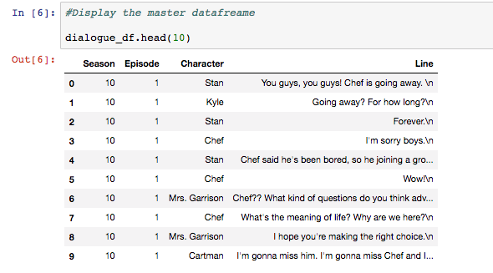
Data description
Get familiar with the data

Slide 6
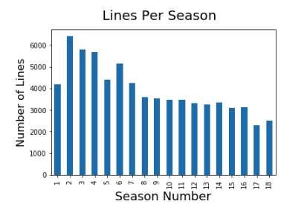
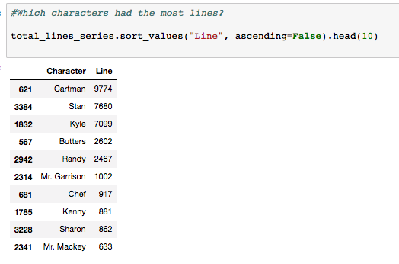
Data Description

Slide 7
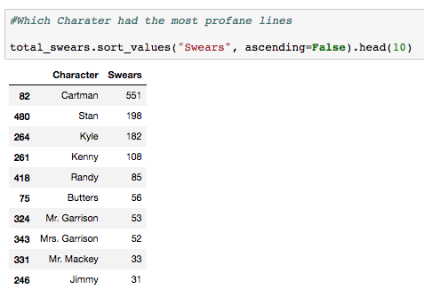
Important stats about profanity
What are some insightful numbers from the dataset?

Slide 8
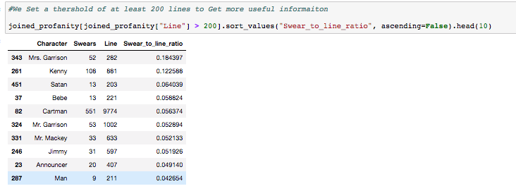
Important stats about profanity
What are some insightful numbers from the dataset?

Slide 9
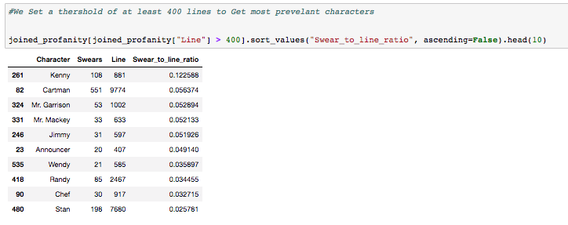
Important stats about profanity
What are some insightful numbers from the dataset?

Slide 10
Line Classification
Overview
Predict who said what line
Almost like a document classification problem

Slide 11
Line Classification
Details
Heuristics
Used only a few characters: Kenny, Kyle, Butters, Stan, Cartman, and Randy
TFIDF
Models
Logistic Regression
Random Forest
Linear SVC
Gaussian Naïve Bayes
Multinomial Naïve Bayes

Slide 12
Line Classification
Results
Models Accuracy
Logistic Regression: 44.68
Random Forest: 32.24%
Linear SVC: 45.03%
Gaussian Naïve Bayes: 22.75%
Multinomial Naïve Bayes: 41.37

Slide 13
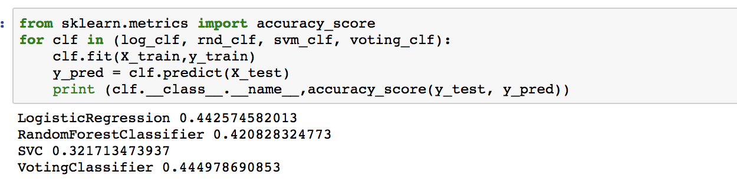
Line Classification
Ensemble
Ensemble
Only ran this once cause it took literally 8-9 hours to run
Not much of a difference

Slide 14
How can we improve the Model?
Other Experiments
Stop Words
Logistic Regression: 41.88
Random Forest: 32.98%
Linear SVC: 39.01%
Gaussian Naïve Bayes: 36.65%
Multinomial Naïve Bayes: 39.53%
By Season? There is some character development in the show. What if we don’t pool all the data into one, would that help?

Slide 15
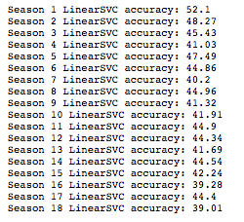
How can we improve the Model?
Not much change

Slide 16
How can we improve the Model?
Suggestions for Further experiments
Create additional features
Utilize swear to line ratio
Word2vec word similarity
Sentiment analysis score
Experiment more with Ensemble; try other combination of models

Slide 17
REFERENCES
https://www.kaggle.com/tovarischsukhov/southparklines/data
http://scikit-learn.org/stable/modules/generated/sklearn.feature_extraction.text.TfidfVectorizer.html

Slide 18
Other instructions [*Do not include slide]
This slide is for instructions only it should not be in your presentation
Title slide:
Introduce yourself, and say a sentence about what this video represents.
audience:
anyone who is interested in the topic.
hashtags/keywords for your video:
CSCI E-29, E-29, Harvard University, Harvard University Extension School, Harvard Extension School, Python, Python3, Data Science
(and others relevant to your presentation)
reproducibility:
You should provide your dataset and .ipynb. Everything you are using has to be available
to the person watching your video. (Exception: Proprietary Data With Instructor Permission)

Slide 19
Grading [*Do not include slide]
We will grade the following
Organization, Clarity (Introduction, Content, Conclusion, References) according to spec and time management (don’t go over 7 minutes)
Complexity, Demonstrated understanding of subject matter and critical thinking
Articulation,Vibrancy, Audience Engagement, Delivery
We recommend that you:
Edit these slides
Export them as images on your GitHub
Load them in your .ipynb notebook and use RISE
Late work will not be accepted. Please plan accordingly. We have a lot of videos to watch and the deadline is final.

Slide 20
Project Categories [*Do not include slide]
Your project qualifies in one of these 3 categories
10 points max (Kaggle process, Machine Learning,Something Original, Discovery oriented [can not be on a dataset included in a library]
9 points max Statistical analysis with Data Visualization with Pandas (other libraries i.e. Bokeh)
8 points max Tutorial on a Data Science topic

